Slide 1
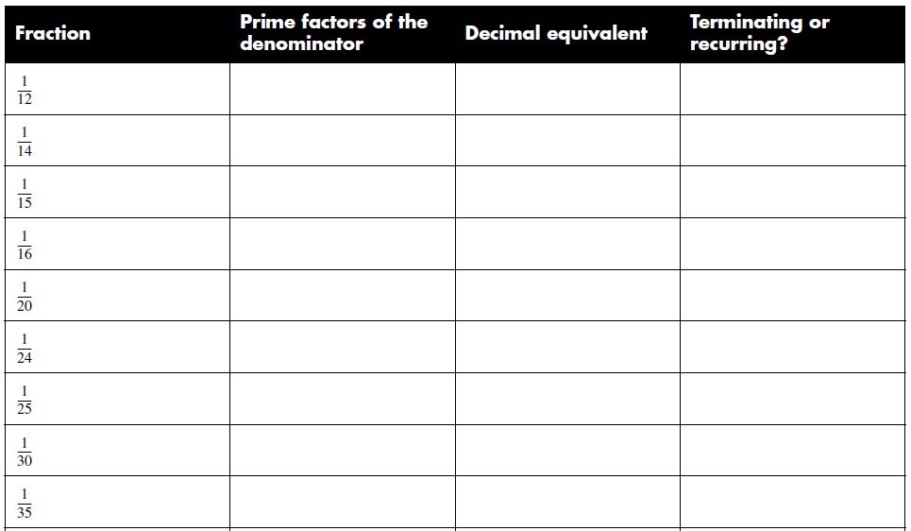
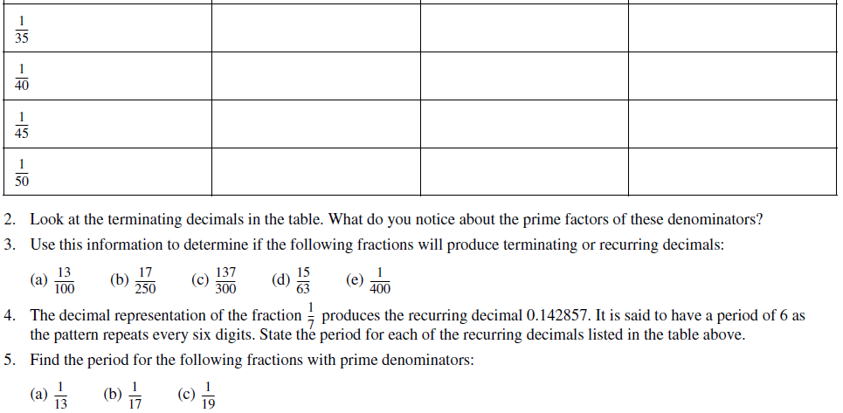
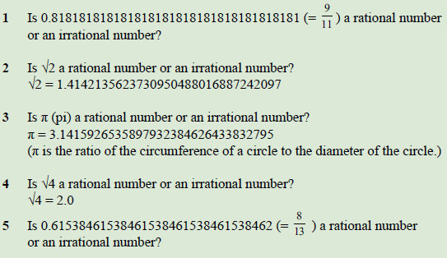
Based on your answers to question 5, can you see a pattern between the length of the repeating section and the denominator?
Rational or Irrational?

